Slide 1

Predicting genes associated with RNA methylation pathways using machine learning

Slide 2
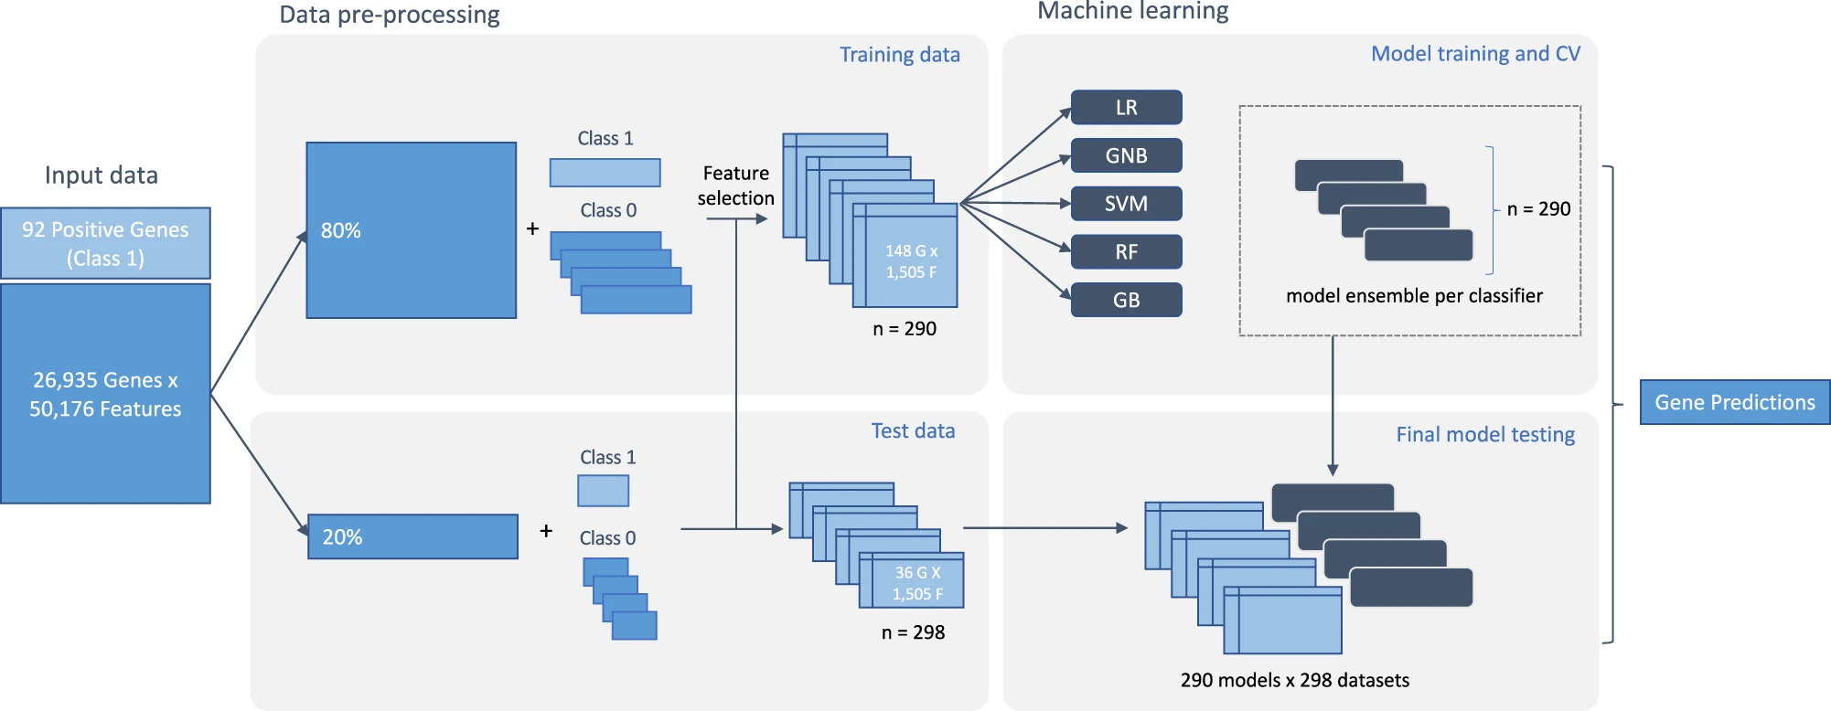
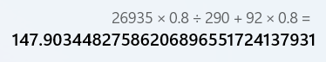
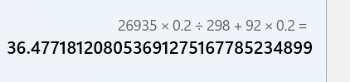
Framework

Slide 3
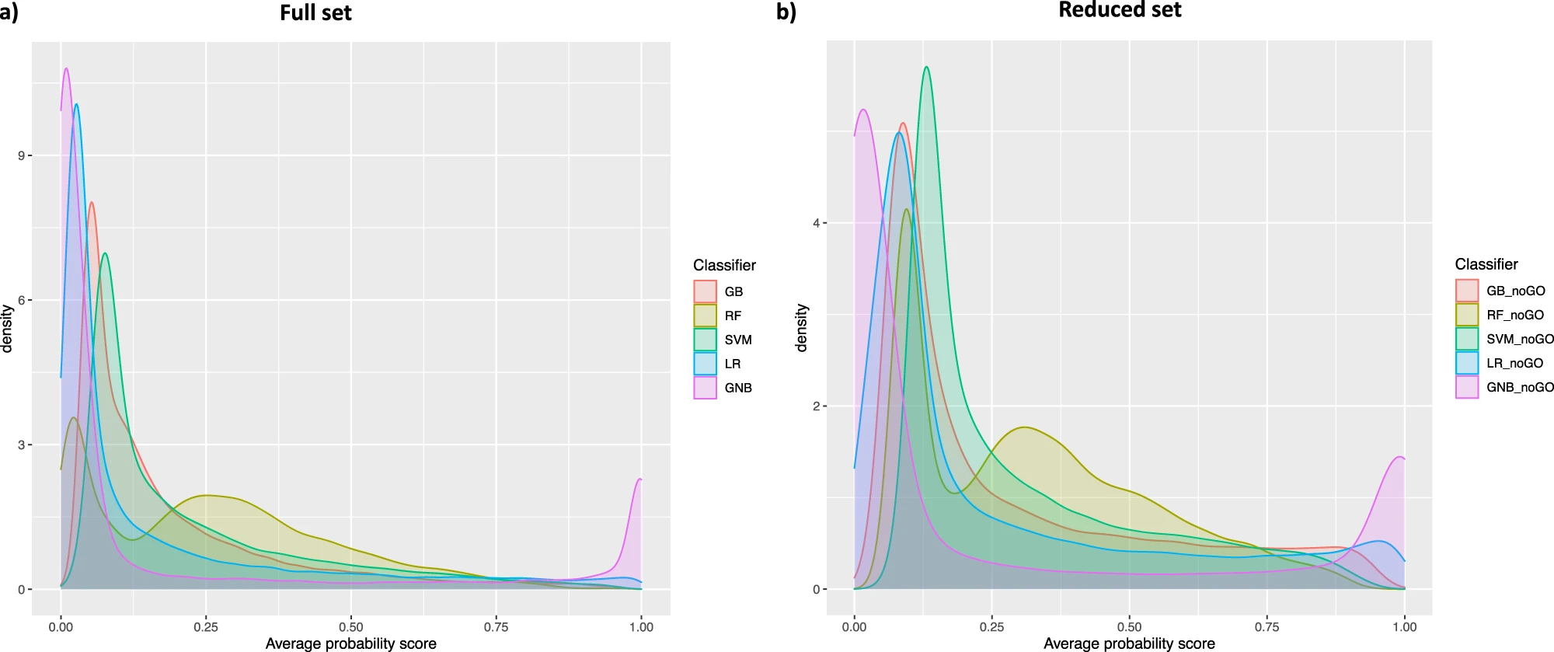
Full set Reduced set 效果比较

